Slide 1
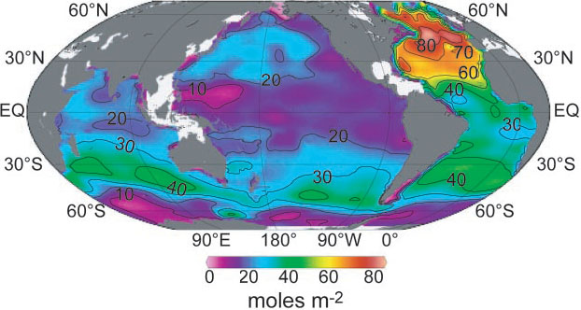
The highest vertically integrated concentrations are found in the North Atlantic. As a result, this ocean basin stores 23% of the global oceanic anthropogenic CO, despite covering only 15% of the global ocean area (table S1). By contrast, the Southern Ocean south of 50°S has very low vertically integrated anthropogenic CO concentrations, containing only 9% of the global inventory.

Slide 2
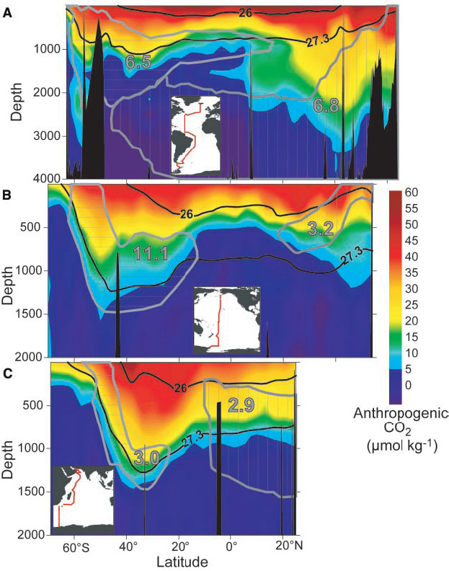

Slide 3
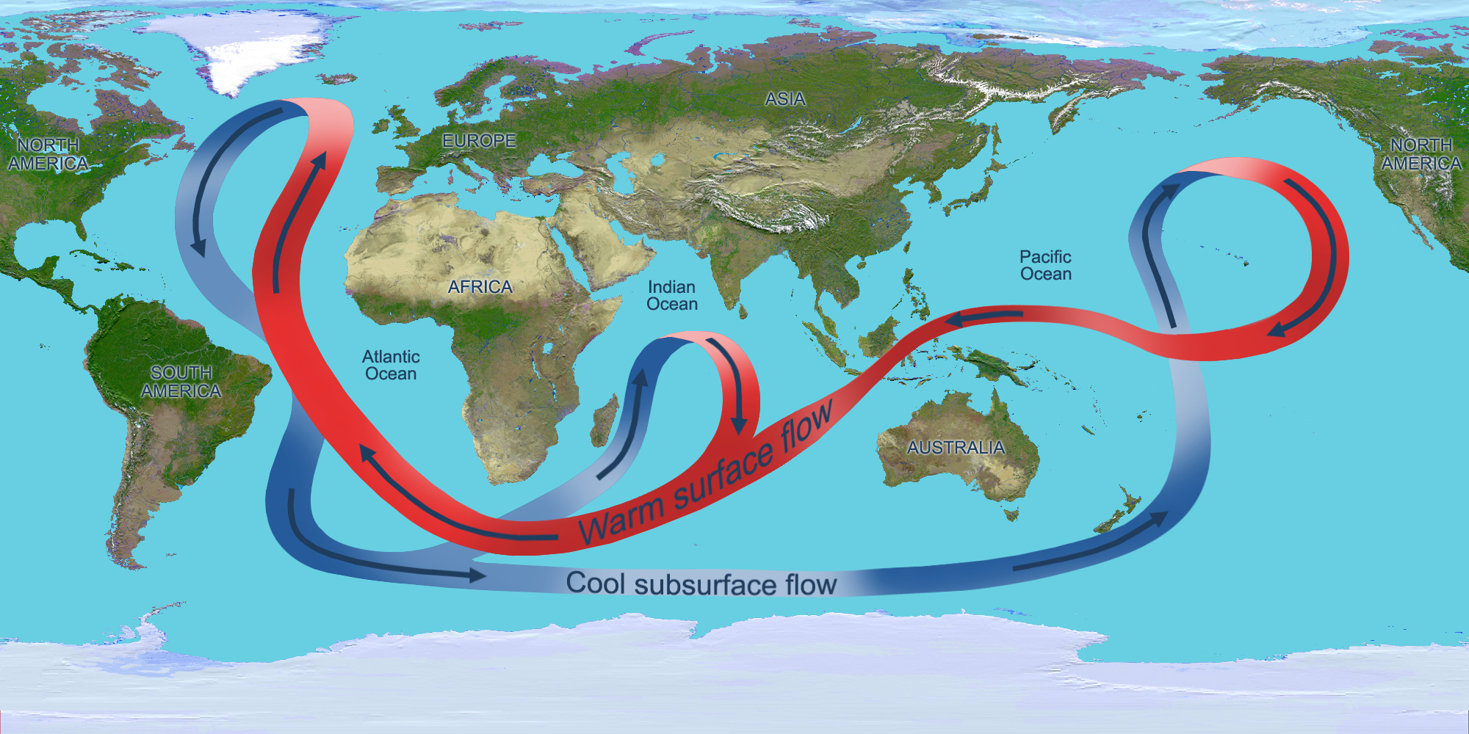

Slide 4
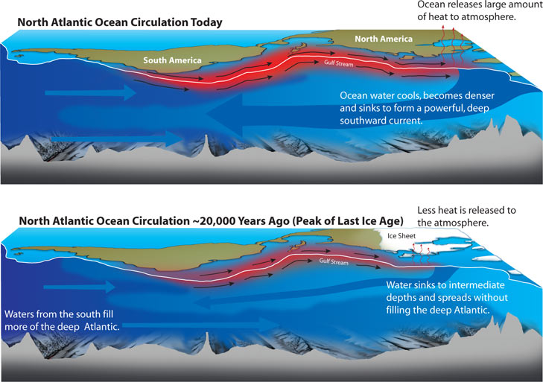

Slide 5
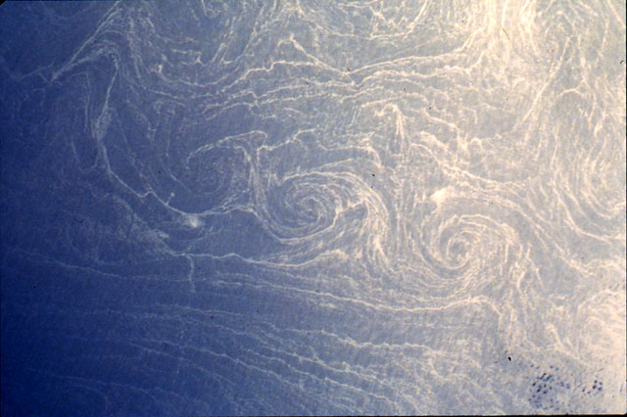
Mediterranean Sea, Shear Wall Spiral Eddies
Ocean Circulation

Slide 6
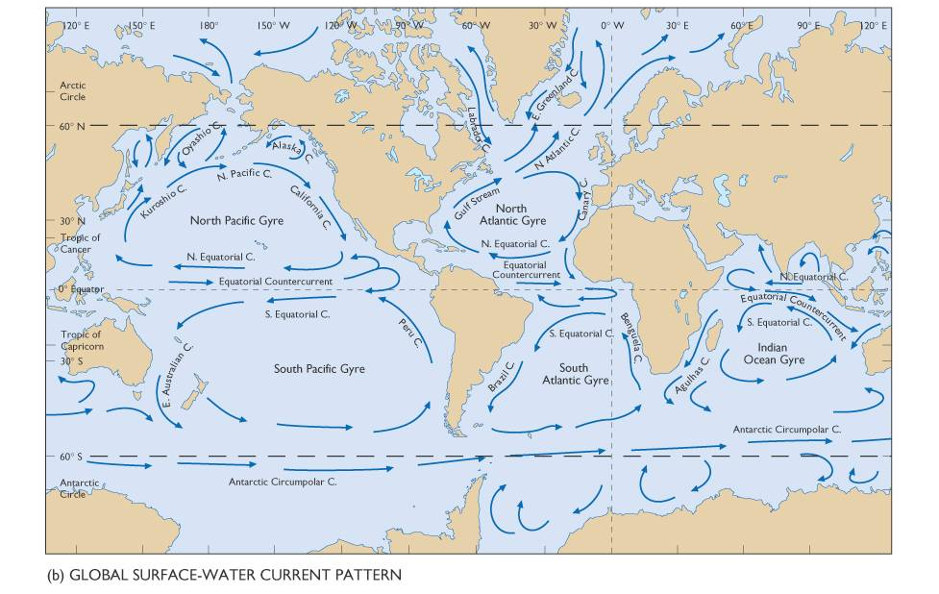

Slide 7
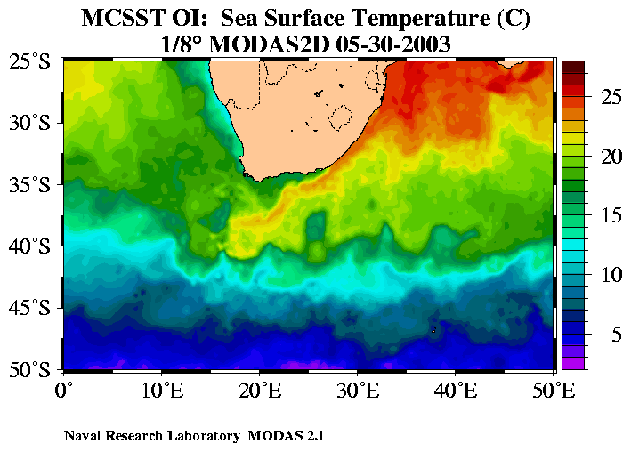
Mean Circulation in
the Ocean

Slide 8
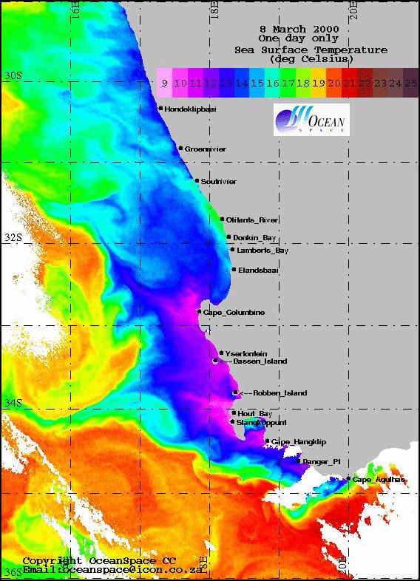
Mean Circulation in
the Ocean
California Current

Slide 9
Two types of Ocean Circulation:

Slide 10
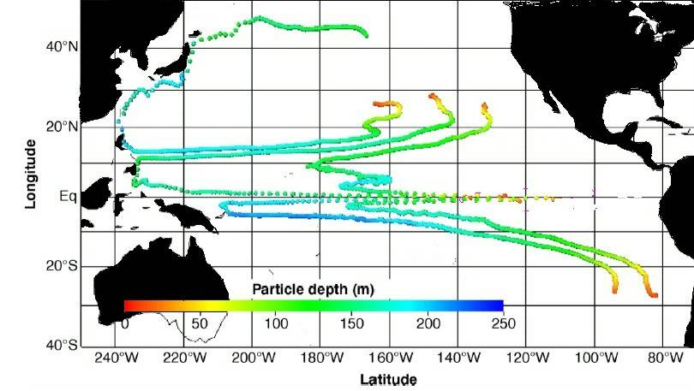
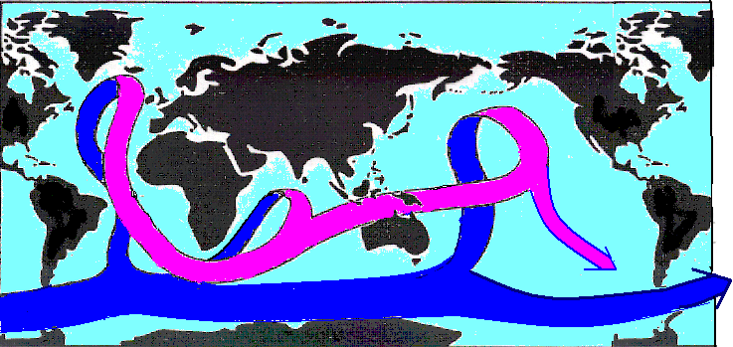
The Shallow, Swift Wind-driven Circulation
The Slow, Deep Thermohaline Circulation
Antarctic
Circumpolar
Circumpolar
Circumpolar
Antarctic
Circumpolar
Circumpolar
Current
Antarctic
Antarctic
Antarctic
Current
Current
Current
Current

Slide 11
Wind driven surface circulation
Learning Objectives
The role of solar heating
How does the wind drive surface currents?
Consider this! – Theories from Ekman, Stommel
West vs East – why the difference
Coastal and open ocean upwelling

Slide 12
What regulates the motion of fluid particles in the ocean and atmosphere?
Forces generating currents
Internal Forces | Forces exerted by wind, thermohaline (TSp)
External Forces | Pressure gradient –solar radiation. Tidal forces
Forces retarding currents | Friction

Slide 13
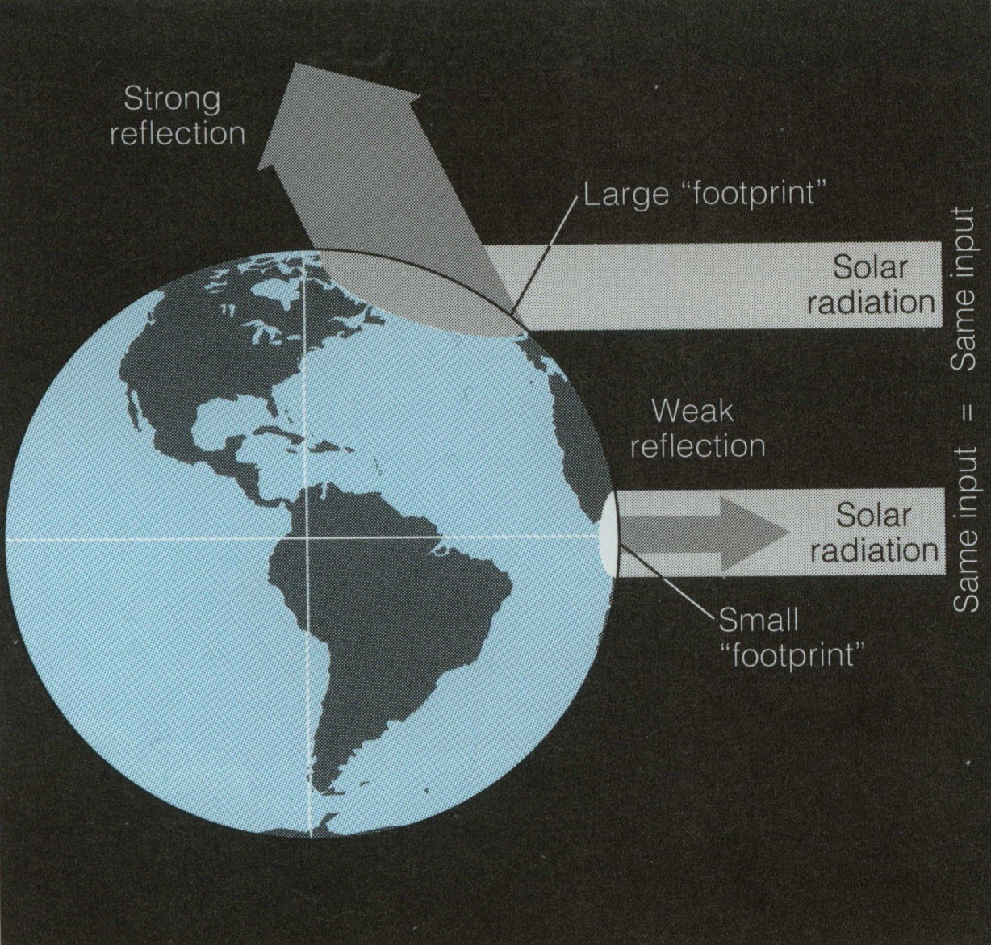
1. What drives ocean currents?
Solar heating is different at different latitudes, because equal amounts of sunlight are spread over a greater surface area near the poles than in the tropics.

Slide 14
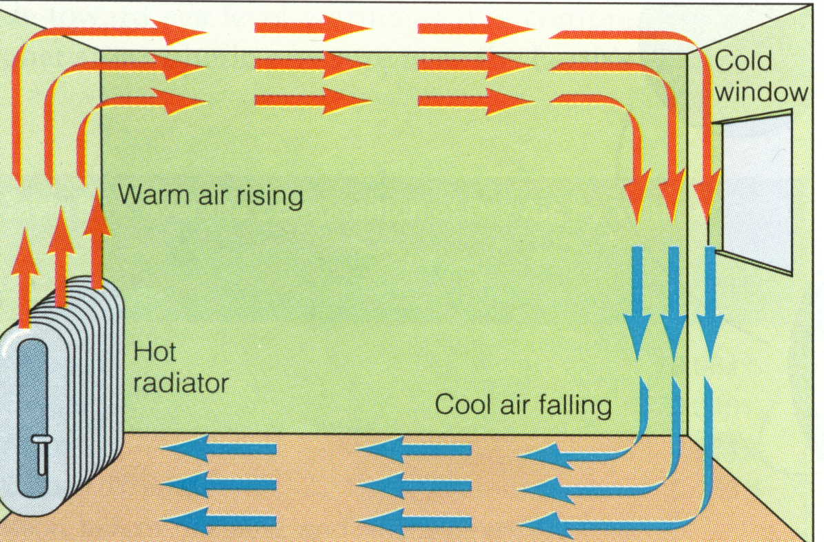
Simplified!! Warm air rises and cool air sinks; a convection current forms in a room resulting from uneven heating and cooling.

Slide 15
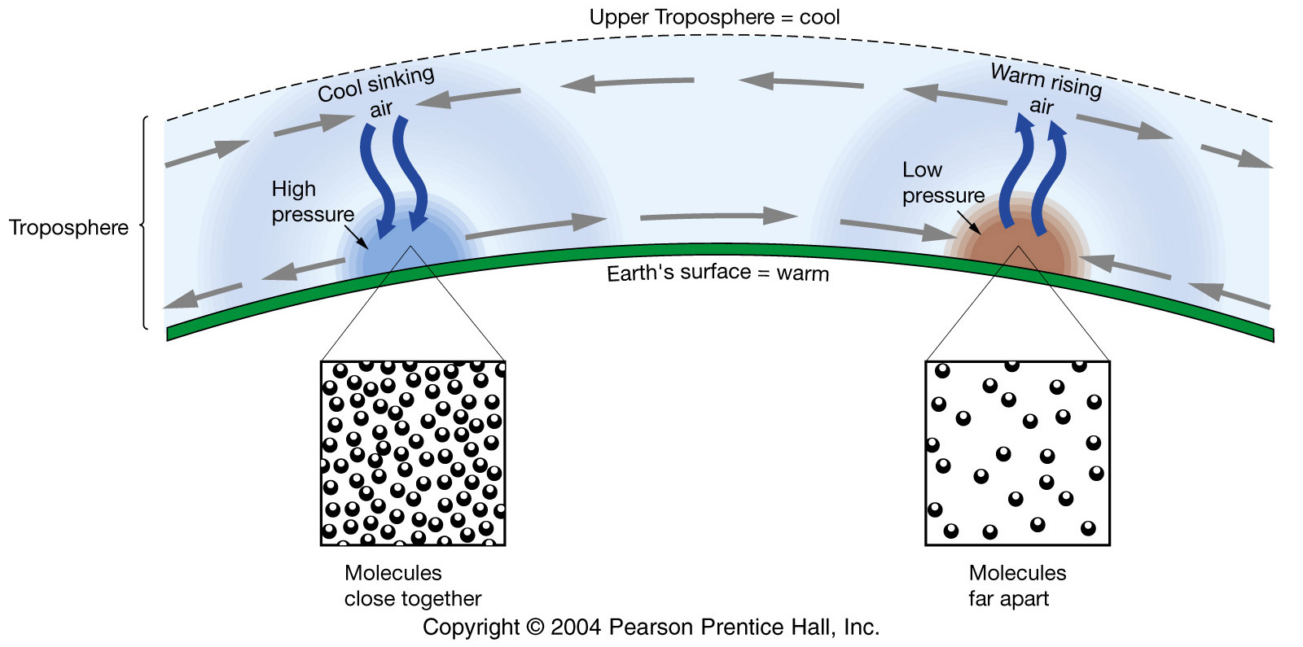
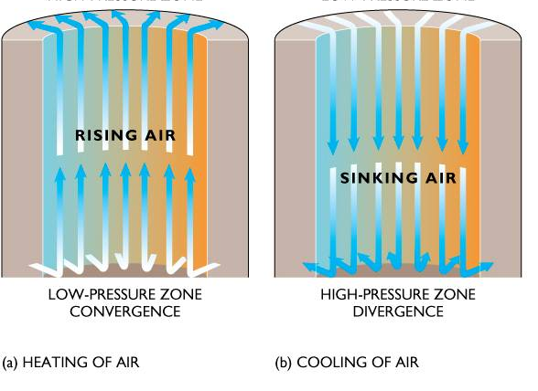
surface
Equator/Tropics
Higher Latitudes

Slide 16
surface
Equator/Tropics
Higher Latitudes

Slide 17
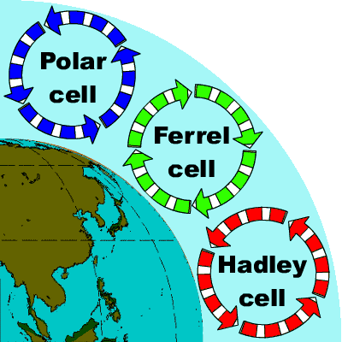
Vertical view of the atmosphere
Equator
Ferrel Cell
Polar Cell
Pole

Slide 18
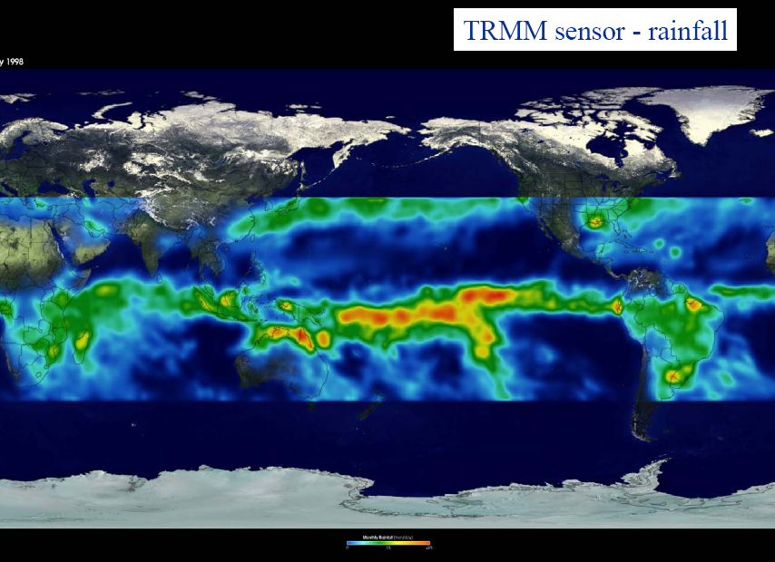
v

Slide 19
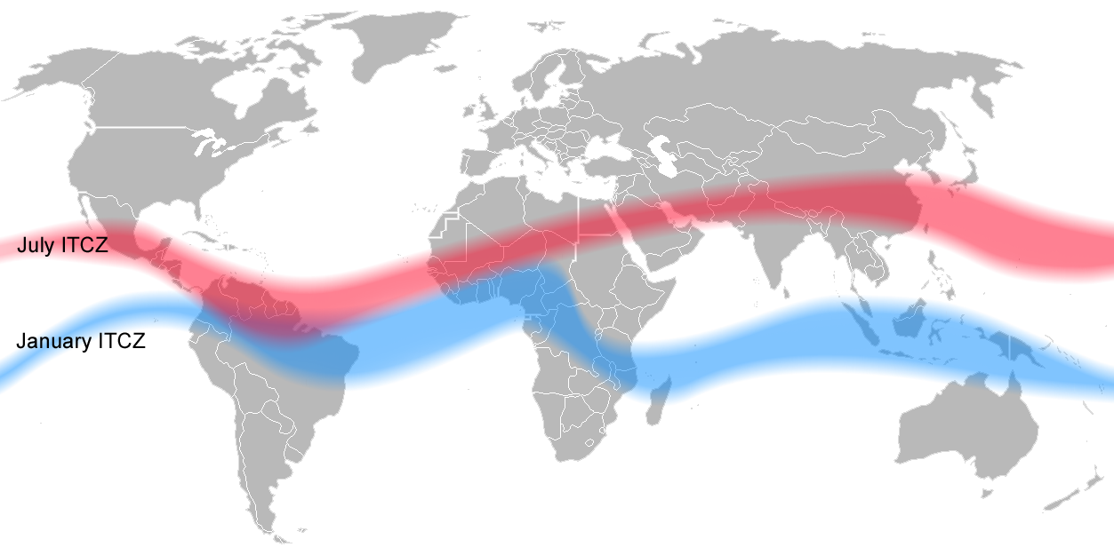

Slide 20
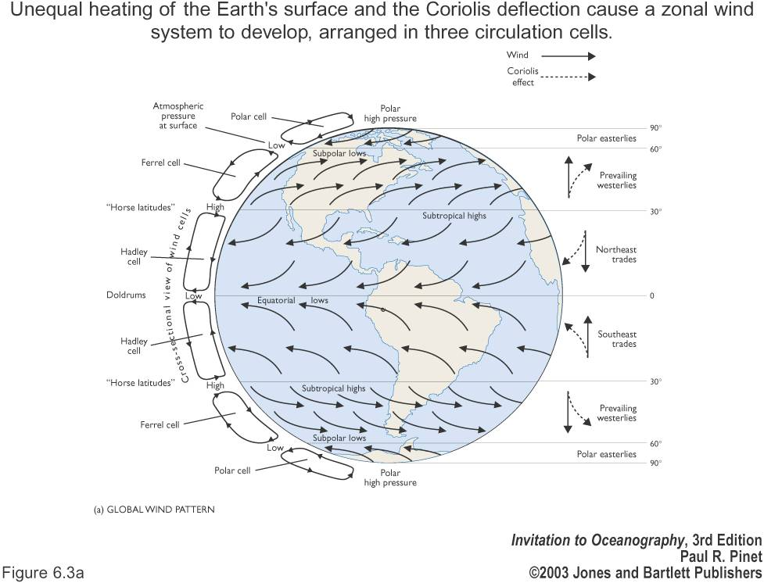
..so that’s the role of solar heating covered… BUT…

Slide 21
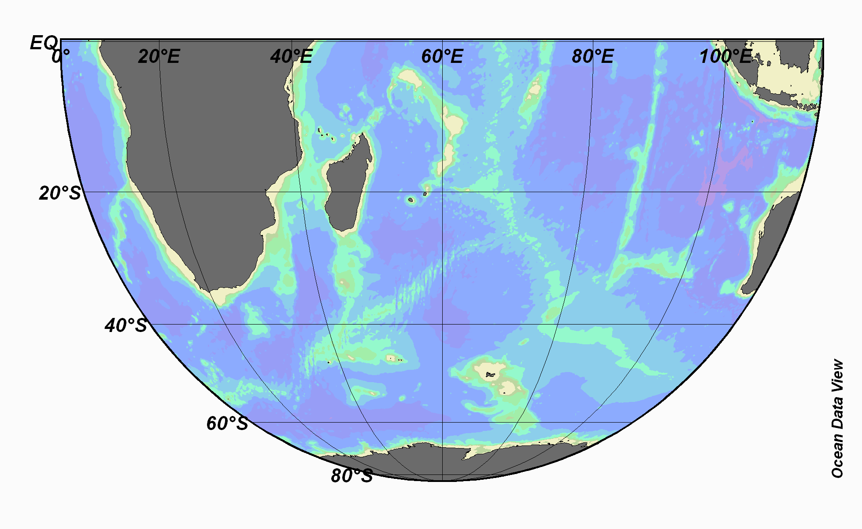
Hadley Cell
Ferrel Cell
Polar Cell

Slide 22
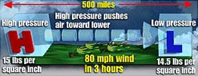
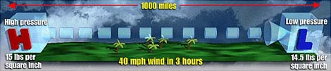

Slide 23
How is the energy of the winds transferred to the ocean?
Ekman Theory …

Slide 24
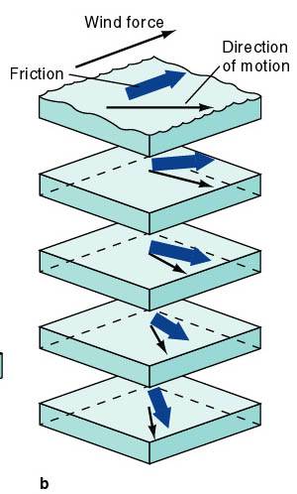
How does wind force propagate in the ocean?
surface
balance between friction and rotation
LEFT IN S. HEMISPHERE
RIGHT IN N. HEMISPHERE
100 meter
depth

Slide 25
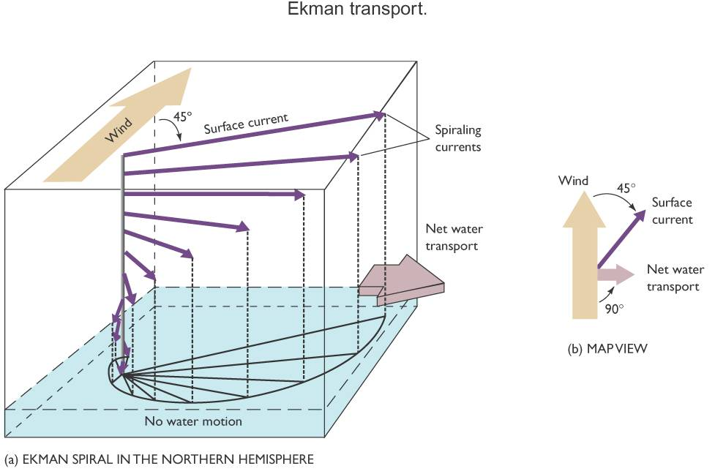

Slide 26
Ekman spiral
Wind transfers kinetic energy to the surface water by friction
This energy is propagated to lower layers in the ocean by friction
Energy is lost at each layer as heat
So the energy at each layer decreases

Slide 27
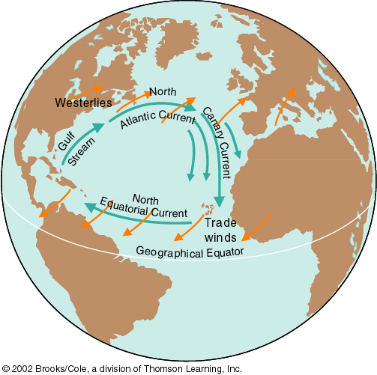
Effects of
Ekman Currents

Slide 28
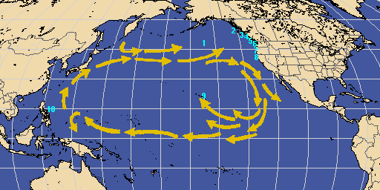
Tracking Currents: The Story of the Lost Nikes
60,000 shoes spilled, May 1990

Slide 29
Wind-driven currents are produced by the interaction between the wind and the water.
As wind moves across the water, energy is transferred from the air to the water.
Water moves at about 3-4% of the wind speed.
Westerly-driven ocean currents in the trade winds, easterly-driven ocean currents in the Westerlies and deflection of the ocean currents by the continents results in a circular current, called a gyre, which occupies most of the ocean basin in each hemisphere.

Slide 30
So, do the gyres just follow the winds?
Not exactly! But the winds get the motion in the ocean started
The oceans respond by flowing and turning
Water piles up in the center of gyres -- several meters high

Slide 31
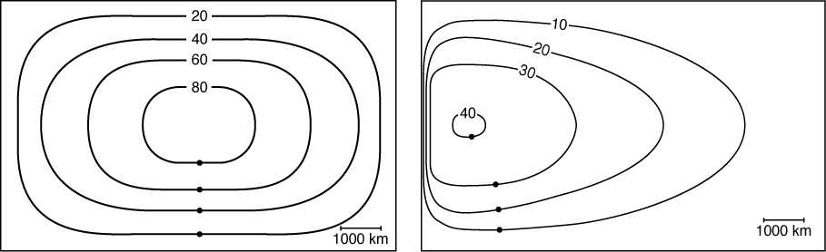

Observed asymmetry of wind-driven gyres
westerlies
trades
what one might expect but the world rotates!!
= LAND

Slide 32
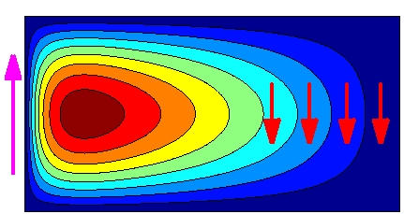

Slide 33
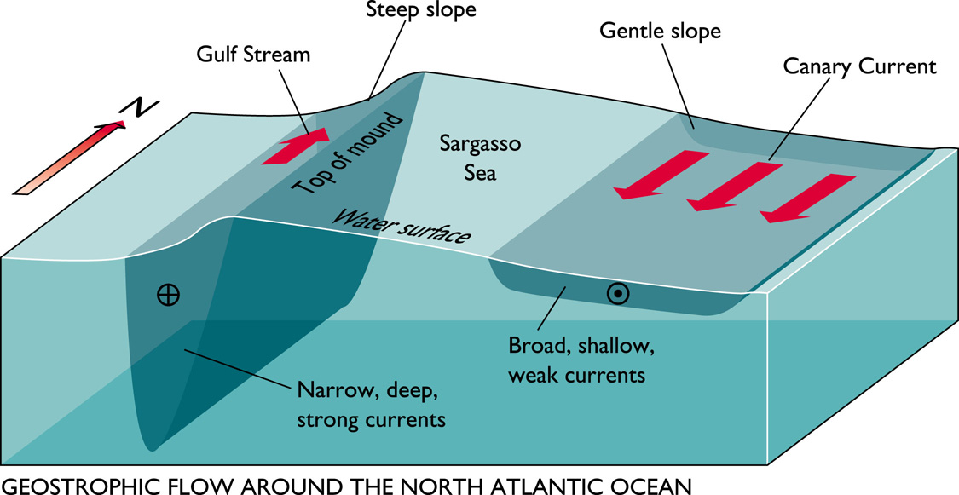

Slide 34
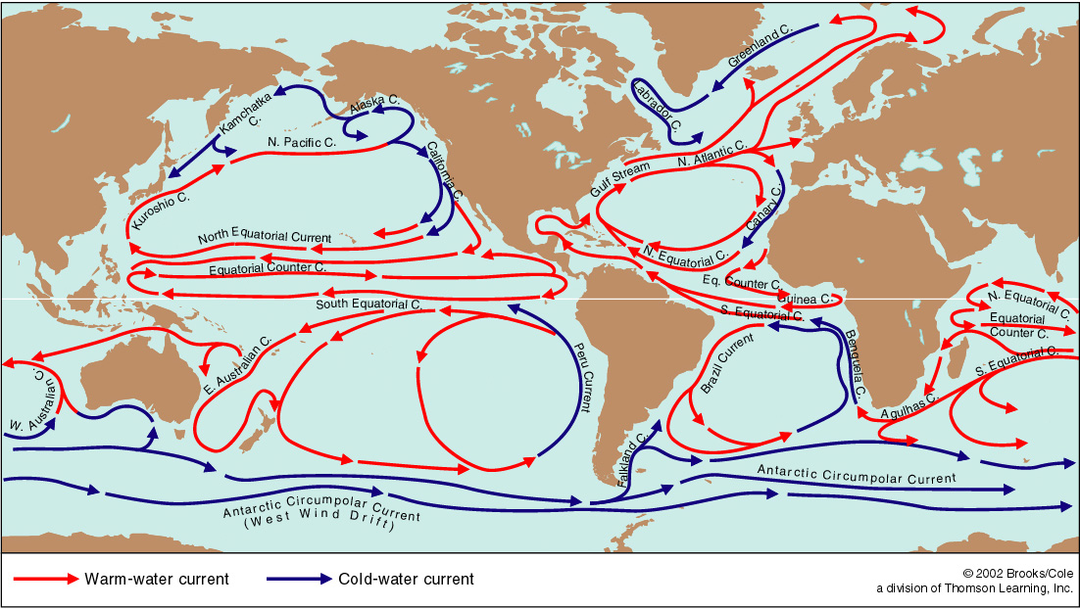
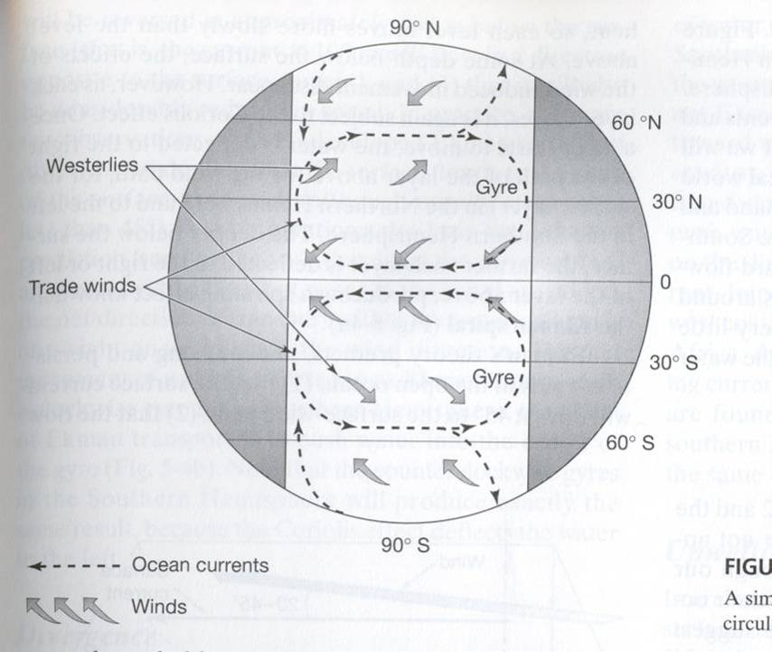
Explanation for gyres
Coriolis effect
Creates primarily east-west flow at equator
Creates west-east flow in mid-latitudes
Thus, gryes tend to be clockwise in the northern hemisphere and counterclockwise in the southern hemisphere

Slide 35
The existence of continents
When the flows hit the continents, it is deflected north or south (depending on the hemisphere)
Lack of continents creates the huge west-wind drift/Antarctic Circumpolar Current in the southern hemisphere

Slide 36
Northern Hemisphere: clockwise
Ekman transport

Slide 37
Southern Hemisphere: counterclockwise
Ekman transport

Slide 38
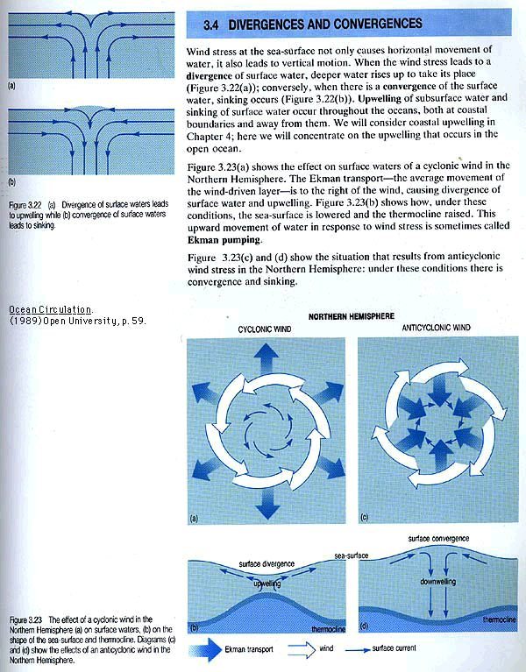
Pressure gradients develop in the ocean because the sea surface is warped into broad mounds and depressions with a relief of about 1m.
Notes:
12

Slide 39
Mounds are caused by convergences, places where water flows together and sinks.
Notes:
12

Slide 40
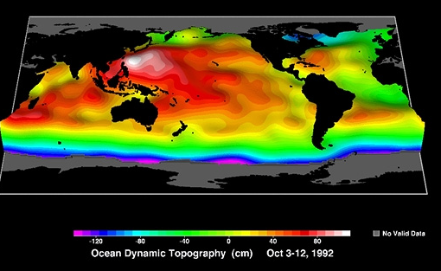
Sea surface height

Slide 41
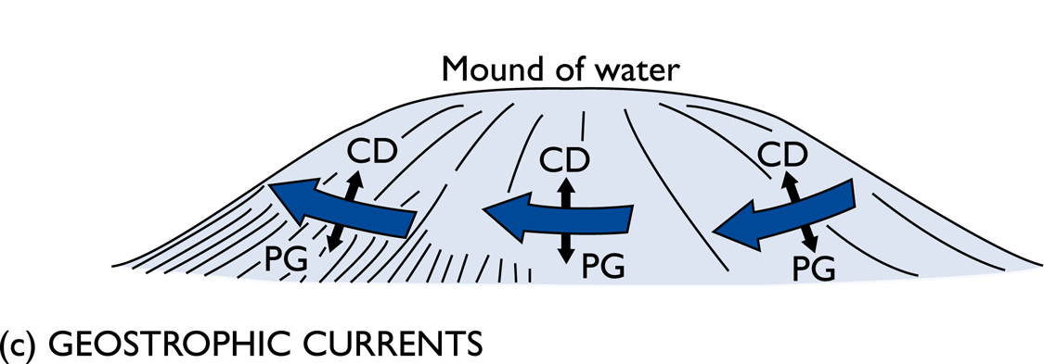
Ekman transport piles up water, or pulls it apart
CD = Coriolis deflection
This creates pressure gradients (PG) within the ocean
Pressure gradient force is balanced by the
Coriolis force = geostrophic flow.
Think of a ball rolling down the hill – the steeper the hill the faster the ball will travel!!!!

Slide 42
Sea surface
Pressure gradient force
Coriolis force
Velocity into page
Geostrophic Balance
Pressure gradient force balanced by Coriolis force

Slide 43
Consequences of Ekman transport
At the center of the gyres:
Convergence
Water tends to pile up
Convergence is associated with downwelling
At the edge of continents, divergence occurs
Divergence is associated with upwelling

Slide 44
Consequences of Ekman transport, Coriolis, and gravity
Ekman transport causes water to pile up in the middle of gyres
Gravity then acts to force it down
Coriolis act in the opposite direction as gravity
The forces balance, and flow tends to occur parallel to the topographic contours
This is called geostrophic flow

Slide 45
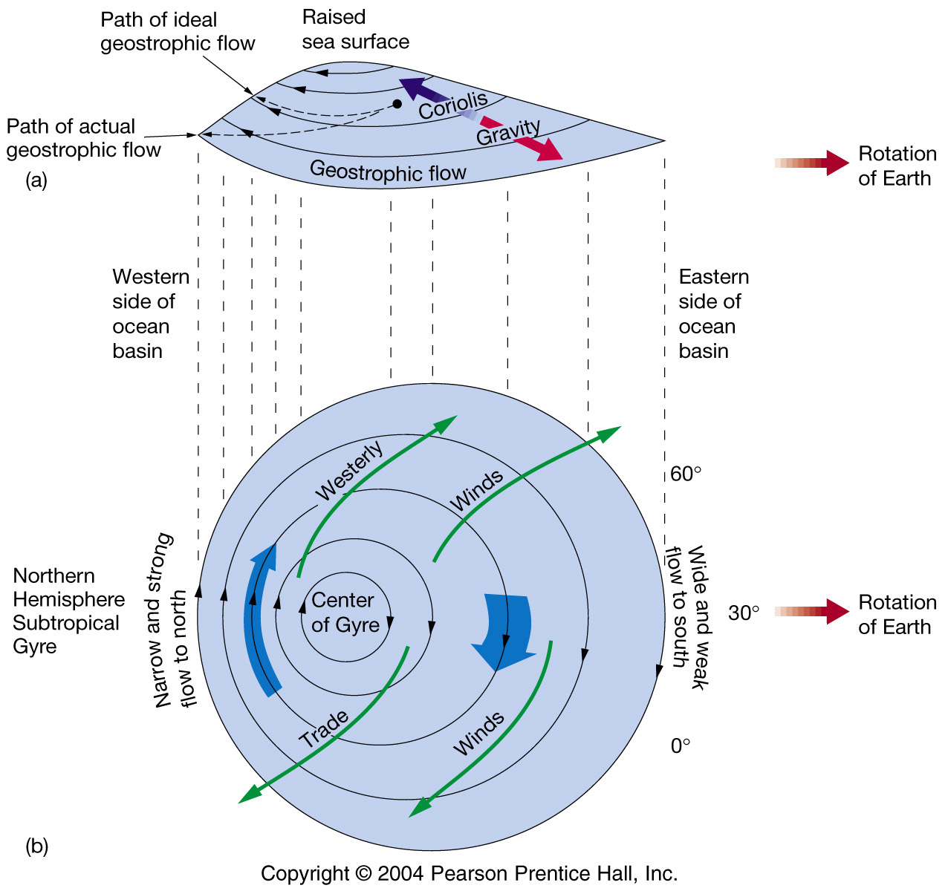
In an idealised world
this mound would be central.
BUT rotation of the earth
means that the flow is
LOP-SIDED!!!

Slide 47
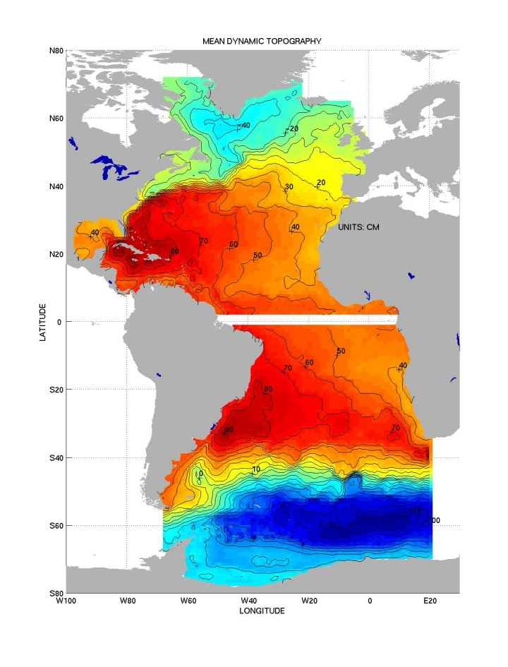

Slide 48
Why is there a difference in direction
at the equator?

Slide 49
For an object travelling on earth in the northern hemisphere the Coriolis force will deflect to the right of its path and to the left of its path in the southern hemisphere. At the equator the force is zero.
There are two reasons for this phenomenon:
(1) the Earth rotates eastward
(2) the velocity of a point on the Earth is a function of latitude
F=2ωsin(ø)
The Coriolis deflection is therefore related to the motion of the object, the motion of the Earth, and the latitude.
ω = rotation of earth = 7.292E⁻⁵ s⁻¹

Slide 50
….importance of coriolis force..
Two important reasons:
(1) the Earth rotates eastwards
(2) the velocity of a point on the Earth is a function of latitude
Coriolis parameter f=2ωsin(ø)
The Coriolis deflection is therefore related to the latitude.
ω = rotation of earth = 7.292E⁻⁵ s⁻¹

Slide 51
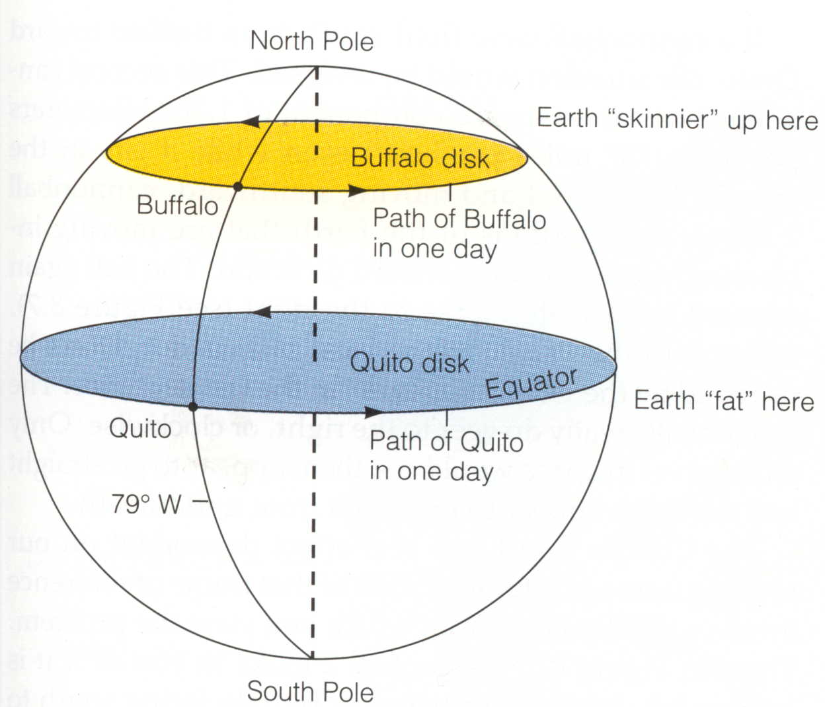
Circumference of the Earth at the Equator = 40,000 kilometers
Time to complete one Rotation = 24 hours
Speed of Rotation = Distance/Time = 40,000 km / 24 hr = 1670 km/hr

Slide 52
Circumference of the Earth at the Equator = 40,000 kilometers
Time to complete one Rotation = 24 hours
Speed of Rotation = Distance/Time = 40,000 km / 24 hr = 1670 km/hr
Circumference of the Earth at 40°N = 30,600 kilometers
Time to complete one Rotation = 24 hours
Speed of Rotation at 40° North = Distance/Time = 30,600 km / 24 hr = 1280 km/hr

Slide 53
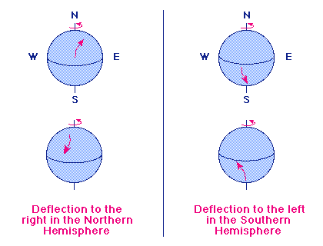
i.e. if a cannon was fired northwards from the Equator, the projectile would land to the east of its due north path because the cannon is moving eastward faster at the Equator than was its target farther north. Similarly, if the weapon were fired from the equator southwards to the South Pole, the projectile would again land to the right of its true path. In this case, the target area would have moved eastward before the shell reached it because of its greater eastward velocity.

Slide 55
